Slide 1
OS Admin
Log files - Linux

Slide 2
Module objectives
After completing this module you will be able to:
Understand the purpose of log files
List common log files
Use commands to display the content of log files
Use commands to view logged-in users

Slide 3
Log Files
Why Use Log Files?
Security Auditing
System Logging

Slide 4
Why use log files?
Troubleshooting
  Information in logs can help diagnose problems with the system or applications.
Security
  Log files can be used to track authorised and unauthorised access to the system.
Most log files stored in /var/log

Slide 5
Log Files
Why Use Log Files?
Security Auditing
System Logging

Slide 6
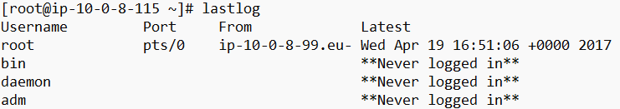
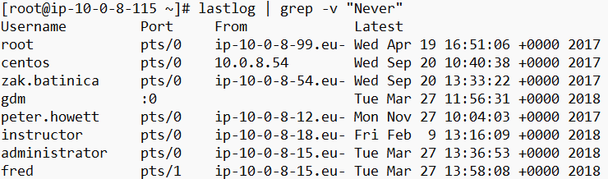
Auditing Users Login using ‘lastlog’
‘lastlog’ command shows the list users with their login information:
To get the list of logged in users only:

Slide 7
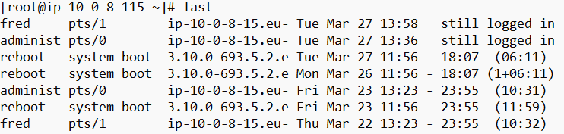
Auditing Users Login using ‘last’
Type the ‘last’ command to see information from the wtmp file.
It records details of logins, logouts and reboots.
  To list all the users still logged in:

Slide 8
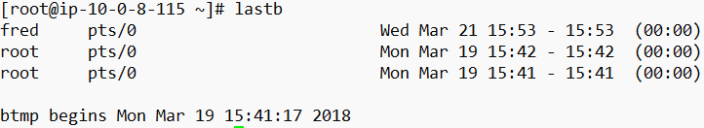
Auditing bad Users Login attempt
Type the ‘lastb’ command to see information from the btmp file.
It records details of all failed login attempts.

Slide 9
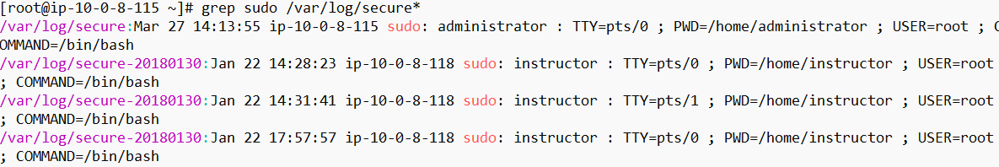
Auditing Root Access
All users’ activities will be recorded in secure files stored in /var/log:
For example we can get information about the use of sudo:

Slide 10
The 'who' command
username
terminal
login time
remote host

Slide 11
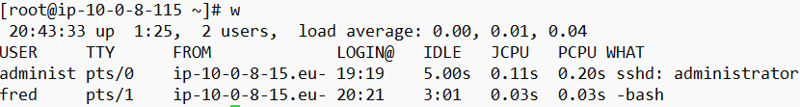
The 'w' command
header: time since system started, number of users logged in, average number of jobs in run queue for last 1, 5 and 15 minutes
minutes since last keystroke
CPU time of running processes
terminal
username
login time
CPU time used since login
current foreground process

Slide 12
Log Files
Why Use Log Files?
Logging System Access
System Logging

Slide 13
Messages Log
This log is the default place where the operating system sends messages about system events.
It can be found in:
/var/log/messages
/var/log/messages-<date>
and they store general information, analysis and debugging messages.
Very important resource and first port of call for trouble-shooting software or hardware problems

Slide 14
Configuring System Logging
We can configure the system logging through the file:
/etc/rsyslog.conf
For example:
  It is configured by default to log all crond jobs activities in the following file:
/var/log/cron
  It is configured by default to log all mail messages in the following file:
  /var/log/maillog

